Slide 1

National University of Computer and Emerging Sciences,
Islamabad, Pakistan
R – CNN Family
CS-4025: Deep Learning
Dr. `Noshina Tariq
Department of AI and DS

Slide 2
Goals
Review of Previous Lecture
Today’s Lecture
R-CNN
Fast R-CNN

Slide 3
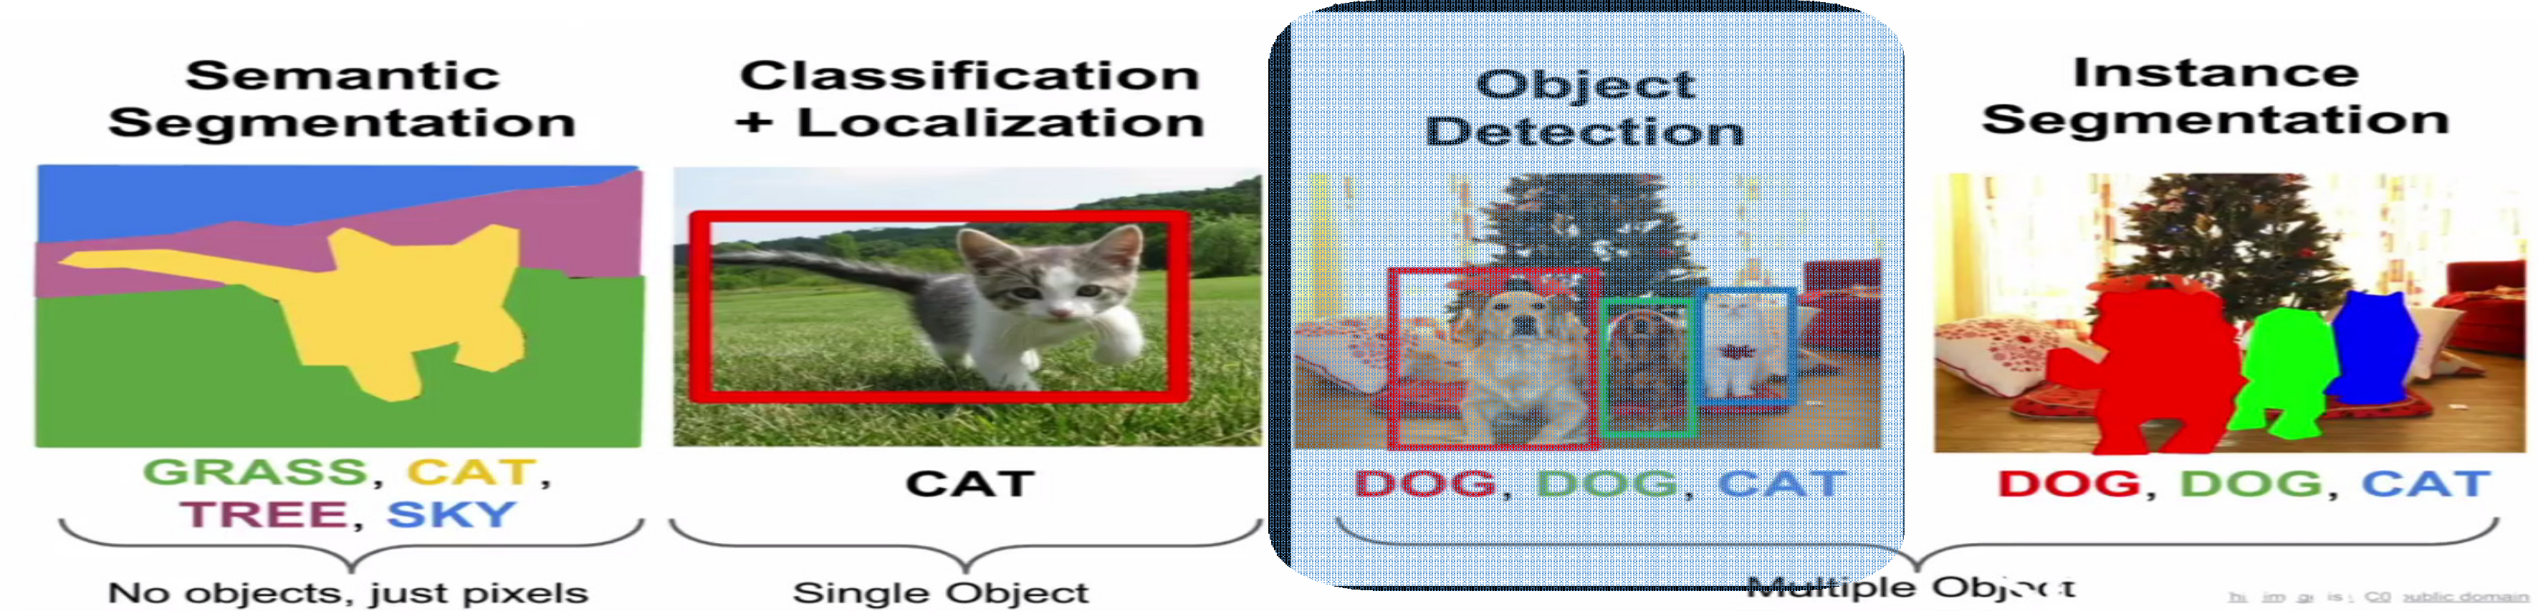
Object Detection

Slide 4
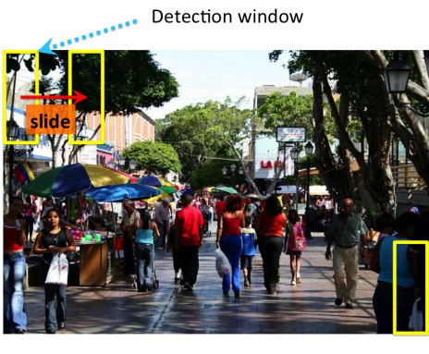
Object Detection as Classification?
Apply a CNN to many different crops of the image, CNN classifies each crop as an object or background
Object detection can actually be viewed as a classification problem. Instead of classifying the entire image, we classify small patches of the image.
We take a small window, slide it across the image, and at every position we ask the classifier a simple question: Is there an object here, or is it just background?
Why This Approach Fails
The idea sounds simple, but the problem is that a single image contains thousands of possible windows. Running a classifier on every one of them becomes extremely slow and computationally expensive.

Slide 5
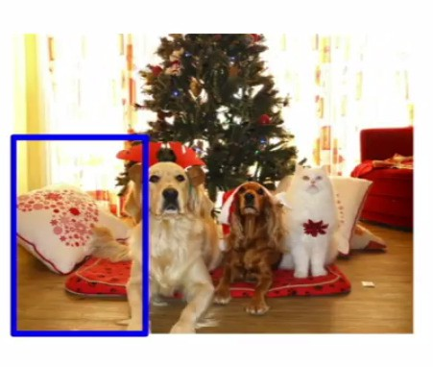
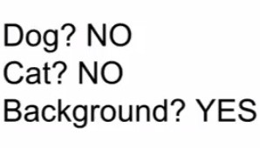
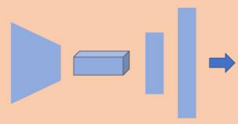
Object Detection as Classification – Sliding Window
When we say the sliding window is being ‘classified,’ we actually mean that the entire CNN — from first convolution all the way to the fully connected layer — must run on that window. And because there are thousands of windows, detection becomes painfully slow.
A sliding window classifier examines every small region and simply decides whether that region contains a specific object or not. It’s a brute-force method, and it must repeat this classification thousands of times per image.

Slide 6
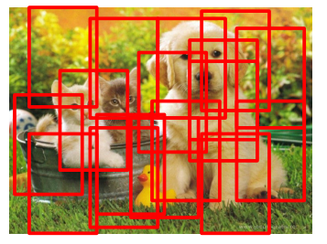
Object Detection as Classification – Sliding Window
Problem: Too many positions & scales to test
Solution: If your classifier is fast enough, go for it
The problem is simple: there are too many possible positions and too many possible sizes of the window. Testing all of them is computationally impossible.

Slide 7
Object Detection as Classification – Sliding Window
Object Detection with CNNs?
CNN classifiers are computationally demanding.
We can’t test all positions & scales ! “More scales simply means we test many different window sizes because the objects can appear at many different sizes in the image.”
Solution: Look at a subset of positions which might contain object.
Choose them wisely :)
Region of Interest

Slide 8
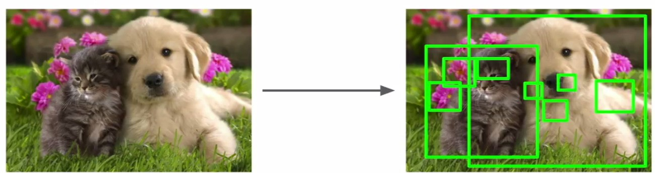
Region Proposals
Find blobby image regions that are likely to contain objects (In computer vision, a blob refers to a group of connected pixels in an image that share common properties, such as intensity, color, or texture. These regions are often treated as distinct objects or areas of interest.)
Selective Search for instance produces ~2000 proposals Many of these do not contain objects but the recall is high
Rich feature hierarchies for accurate object detection and semantic segmentation
https://arxiv.org/abs/1311.2524

Slide 9

R-CNN

Slide 10
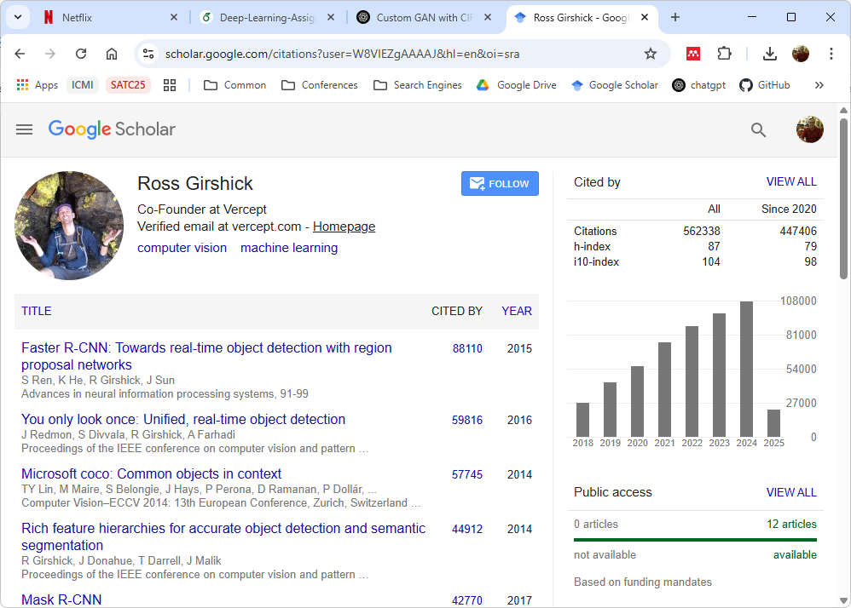

Slide 11
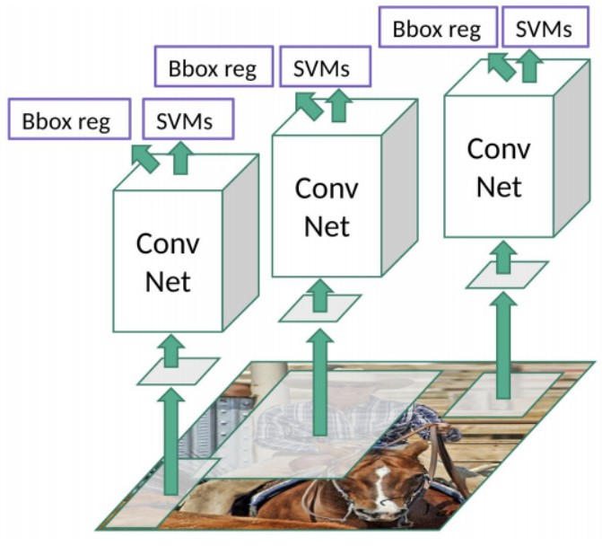
R-CNN
R-CNN (Girshick et al., 2014) is short for “Region-based Convolutional Neural Networks”.
The main idea is composed of following steps:
Find Region Proposals: Smaller parts of the original image, that we think could contain the objects we are searching for.
Extract CNN features from each region independently for classification.
Apply bounding box regression to localize the objects

Slide 12
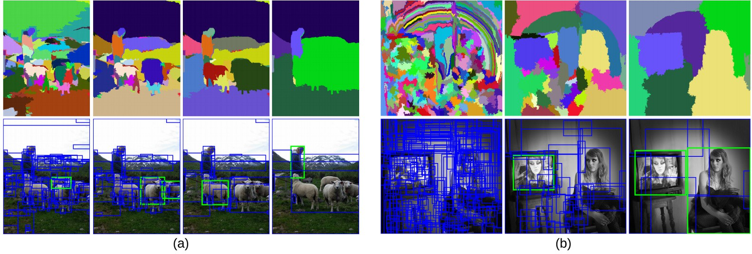
R-CNN: Region Proposals
Qasim
2020-06-29 01:08:34
--------------------------------------------
Selective Search is a computer vision technique
R-CNN creates category-independent regions of interest (~2k candidates per image) using a process called Selective Search
At a high level, Selective Search looks at the image through windows of different sizes, and for each size tries to group together adjacent pixels by texture, color, or intensity to identify objects.

Slide 13
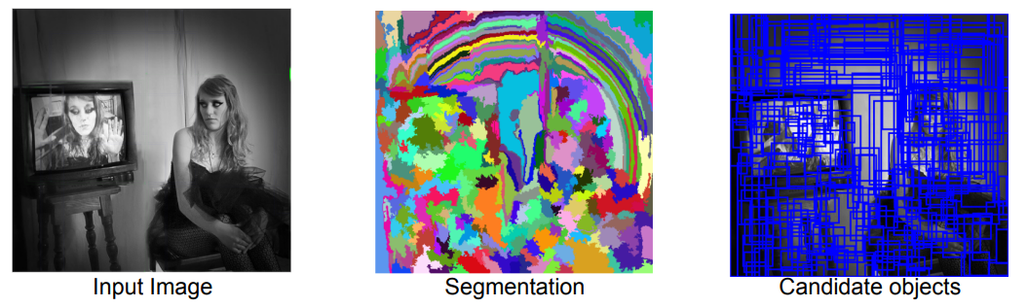
Selective Search
Step 1: Generate initial sub-segmentation
Goal: Generate many regions, each of which belongs to at most one object, using a segmentation algorithm.

Slide 14
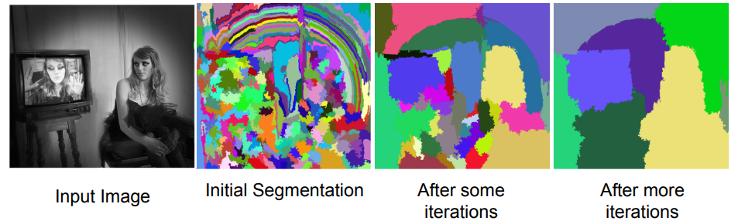
Selective Search
Step 2: Recursively combine similar regions into larger ones. This process is much faster than sliding windows because we do not generate random boxes — we only propose regions whose shape, color, or texture suggests that they may contain an object. Region proposals are a small set of bounding boxes that are likely to contain objects. They are generated using algorithms like Selective Search.
From set of regions, choose two that are most similar.
Combine them into a single, larger region.
Repeat until only one region remains.
This yields a hierarchy of successively larger regions.

Slide 15
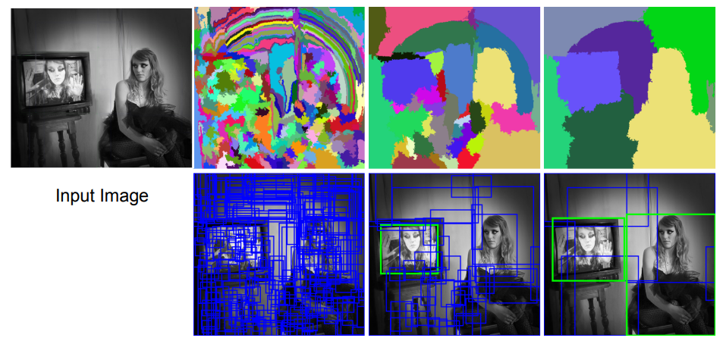
Selective Search
Use the generated regions to produce candidate object locations. Selective Search breaks the image into small segments, repeatedly merges similar regions, and finally produces a set of object-like candidate boxes. These are the region proposals used by R-CNN.

Slide 16
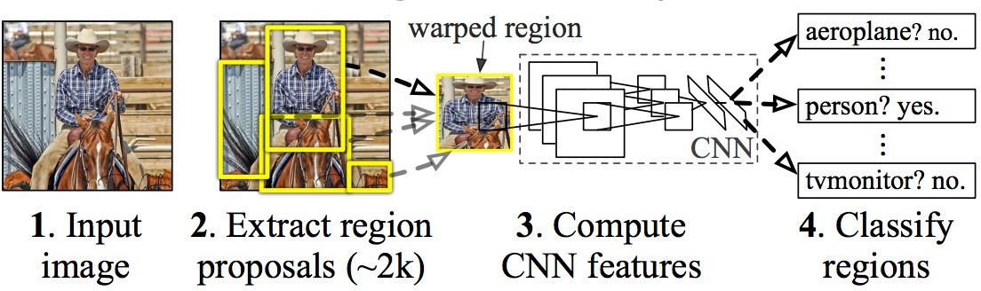
R-CNN: Work flow
R-CNN takes ~2000 region proposals, warps each region to a fixed size, extracts deep CNN features, and classifies each region independently using SVMs.

Slide 17
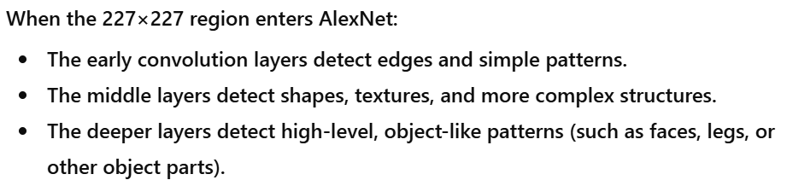
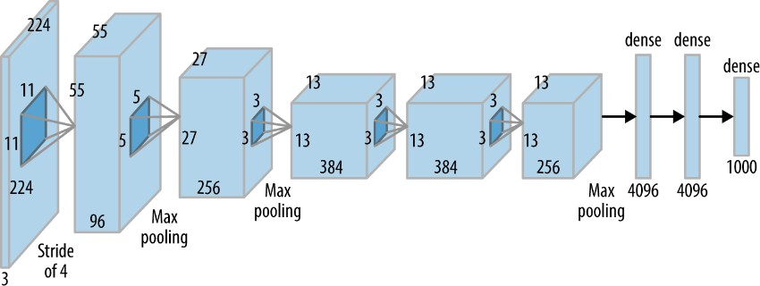
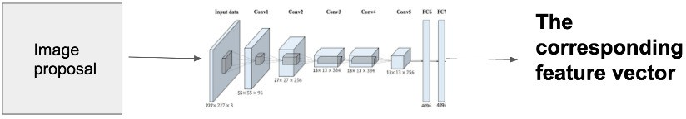
R-CNN: Feature Extraction
Once the proposals are created, R-CNN warps (resize, stretch, fit) the region to a standard size (227, 227, 3) and passes it through to a modified version of AlexNet (the winning submission to ImageNet 2012 that inspired R-CNN)
edges
colors
textures
shapes
patterns

Slide 18
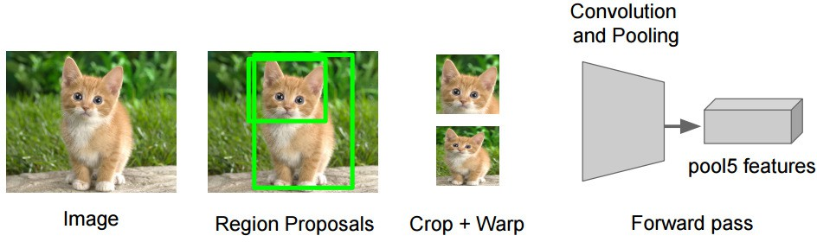
R-CNN: SVM
On the final layer of the CNN, R-CNN adds a Support Vector Machine (SVM) that simply classifies whether this is an object, and if so what object.
The SVM is trained on feature vectors created by the AlexNet.
We reject a region (image proposal) if it has an intersection-over-union (IoU) overlap with a higher scoring selected region (Non-maxima suppression). Meaning if two boxes cover the same object and their overlap is very high, we keep only the highest-scoring box and discard the others.

Slide 19
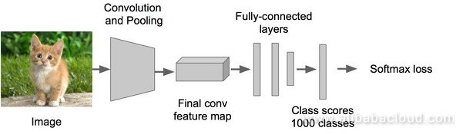
R-CNN: Work flow Step 1
Take a pre-trained ImageNet CNN (e.g. Alexnet)
Input Image: The raw image is given to the CNN. In this case, it’s a picture of a kitten.
Convolution and Pooling: The image passes through several convolution layers that detect edges, textures, and shapes, followed by pooling layers that reduce the spatial size while keeping important information. These layers together extract meaningful visual features from the image.
Final Convolution Feature Map: After multiple convolution + pooling operations, the network produces a compact feature map. This feature map contains high-level information about the image, such as patterns and object parts.
Fully Connected Layers: The feature map is flattened and passed through fully connected layers. These layers combine the extracted features to compute class-specific signals.
Class Scores (e.g., 1000 classes): The last fully connected layer outputs raw scores for each possible class. For example, in ImageNet, the CNN produces scores for 1000 different categories.
Softmax Loss / Softmax Output: Softmax converts the class scores into probabilities, highlighting the most likely class. During training, softmax loss is used to compare the predicted probability with the true label and adjust the model.

Slide 20
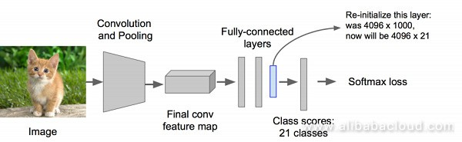
R-CNN: Work flow Step 2
R-CNN begins by applying Selective Search to the input image to generate roughly 2000 region proposals. These are candidate boxes where an object might be present.
Continue fine-tuning the CNN on warped proposal regions for K + 1 classes; The additional one class refers to the background (no object of interest). For example: If you have 20 object categories, R-CNN trains a classifier for 21 classes (20 objects + background).
Each region proposal is considered a positive for the class with which it has an intersection-over-union (IoU) of at least 0.5 with a ground-truth bounding box from the dataset.
Re-initialize means resetting the last layer with new weights because R-CNN needs a different number of output classes than the original ImageNet network.

Slide 21
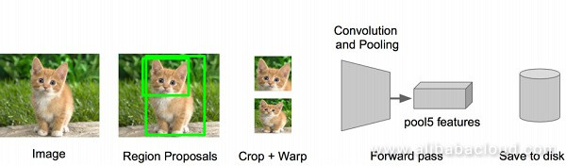
R-CNN: Work flow Step 3
After generating region proposals (the green boxes), R-CNN takes each individual region and sends it through the CNN. This process is called forward propagation — meaning the region is passed layer-by-layer through the convolution and pooling layers, just like a normal image classification pipeline.
Forward propagate each region proposal through the tuned convolutional neural network to generate a 4096-dimensional feature vector. R-CNN crops each proposed region, resizes it, runs it through the CNN, and extracts a 4096-dimensional feature vector that represents what is inside that region.

Slide 22
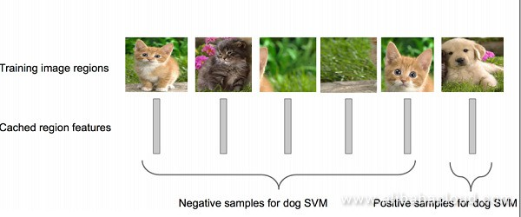
R-CNN: Work flow Step 4
Train an SVM classifier (2 categories) to determine the category of objects in this candidate box.
One binary SVM for each class
R-CNN trains one binary SVM for each class. Positive samples are regions containing the object (IoU > 0.5), while all other regions become negative samples. The SVM learns to classify region features extracted from AlexNet.

Slide 23
R-CNN: Work flow
Step 5
Use regression to fine-tune the position of the candidate boxes.
For each class, train a linear regression model to determine if the box is optimized.
How to determine which ground-truth box maps appropriately to a given proposal?
A proposal P is assigned to the G with which it has maximal IoU overlap, as long as that overlap exceeds some empirically determined threshold (0.6 in the case of the original R-CNN).

Slide 24
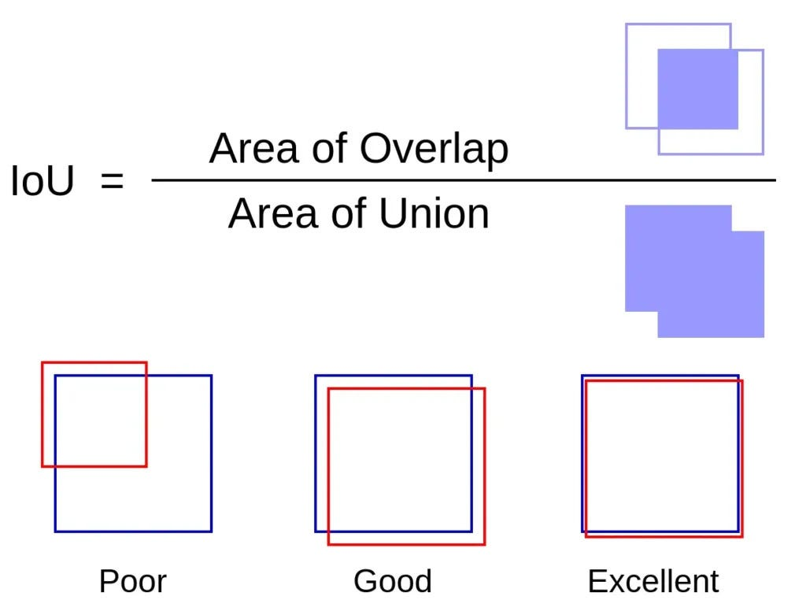
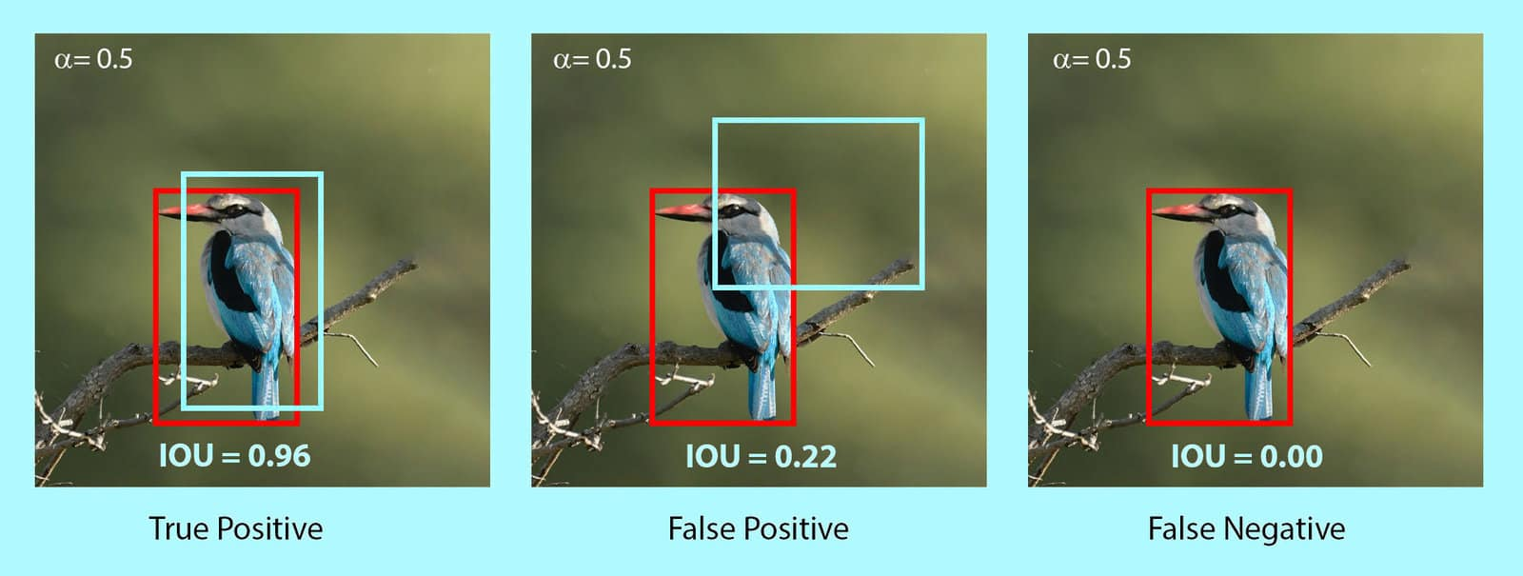
R-CNN: Work flow

Slide 25
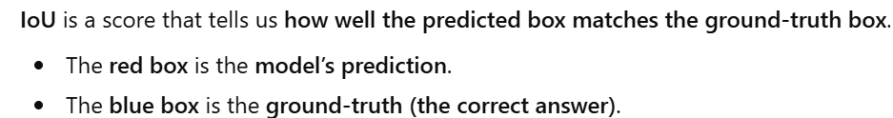
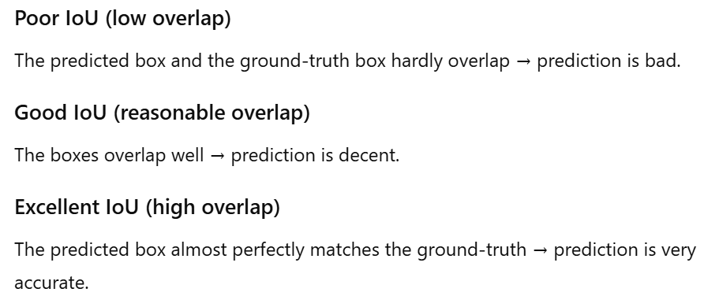
R-CNN: Work flow

Slide 26
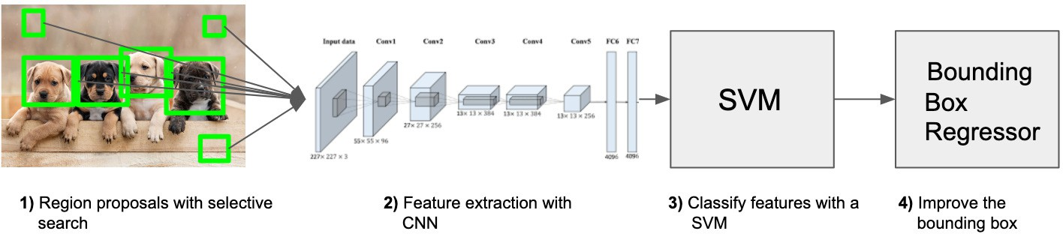
R-CNN: Work flow

Slide 27
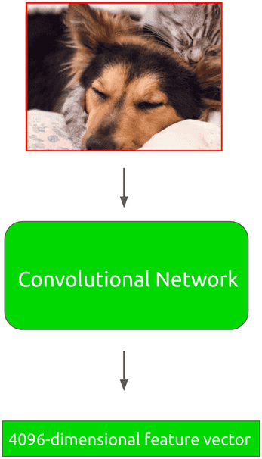
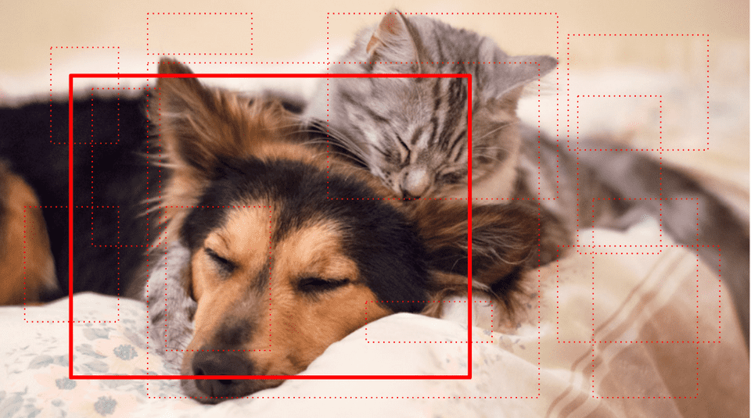

R-CNN: Visual Summary

Slide 28
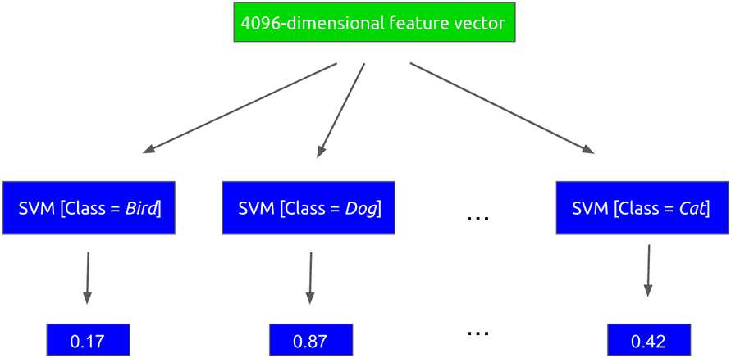
R-CNN: Visual Summary

Slide 29
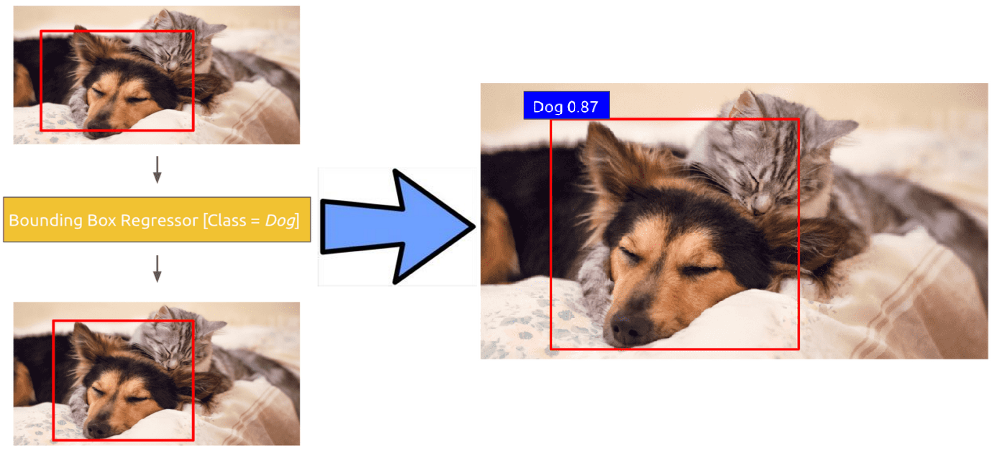
R-CNN: Visual Summary

Slide 30
R-CNN: Training
There are effectively three separate steps of the training process that require data:
CNN fine-tuning
SVM classifier training
Bounding box regressor training
https://lilianweng.github.io/lil-log/2017/12/31/object-recognition-for-dummies-part-3.html
https://www.mihaileric.com/posts/object-detection-with-rcnn/

Slide 31
R-CNN: Problems
It takes a huge amount of time to train the network as we need to classify 2000 region proposals per image
It cannot be implemented real time as it takes around 47 seconds for each test image.
The selective search algorithm is a fixed algorithm.
Therefore, no learning is happening at that stage.
This could lead to the generation of bad candidate region proposals.

Slide 32
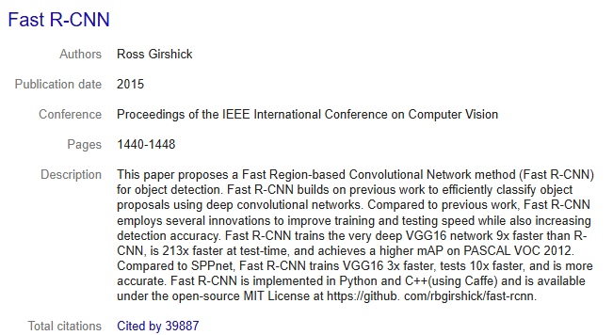
Fast R-CNN
2015: Fast R-CNN - Speeding up and Simplifying R-CNN
https://arxiv.org/abs/1504.08083

Slide 33
Fast R-CNN
R-CNN Bottlenecks
It requires a forward pass of the CNN (AlexNet) for every single region proposal for every single image (that’s around 2000 forward passes per image!).
It has to train three different models separately
The CNN to generate image features
The SVM classifier that predicts the class
The regression model to tighten the bounding boxes.
This makes the pipeline extremely hard to train.
Fast R-CNN Key Ideas:
ROI Pooling – Run the CNN only once on the image
Combine the bounding box regression and classification in a single network

Slide 34
Fast R-CNN
The approach is similar to the R-CNN algorithm; but instead of feeding the region proposals to the CNN, we feed the input image to the CNN to generate a convolutional feature map.
From the convolutional feature map, we identify the region of proposals and warp them into squares and by using a ROI pooling layer we reshape them into a fixed size so that it can be fed into a fully connected layer.
From the ROI feature vector, we use a softmax layer to predict the class of the proposed region and also the offset values for the bounding box.

Slide 35
Fast R-CNN
The reason Fast R-CNN is faster than R-CNN is because we do not have to feed 2000 region proposals to the convolutional neural network every time.
Instead, the convolution operation is done only once per image and a feature map is generated from it.

Slide 36
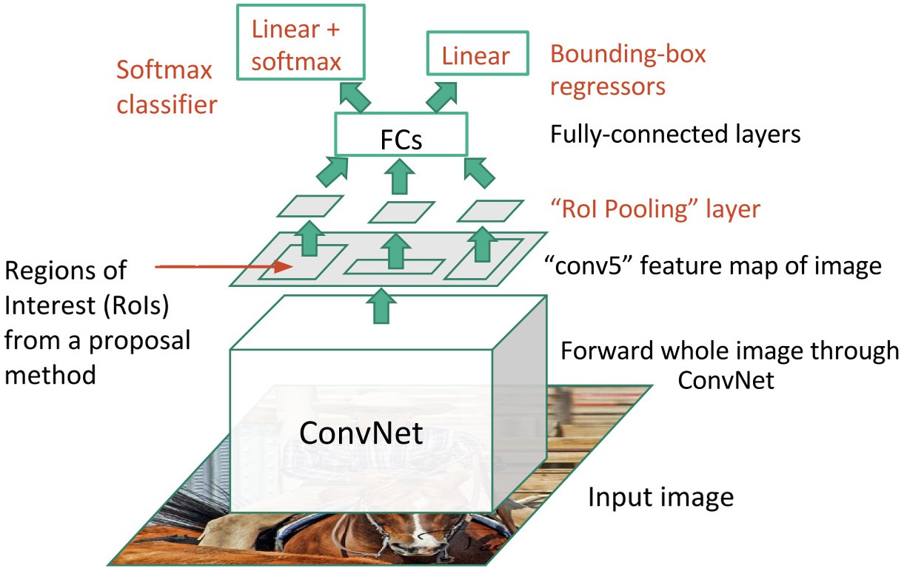

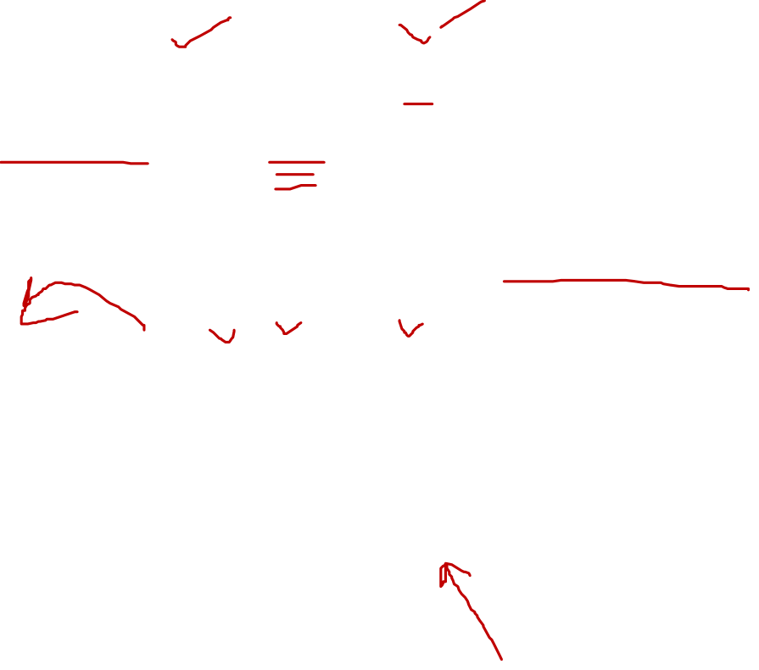
Fast R-CNN

Slide 37
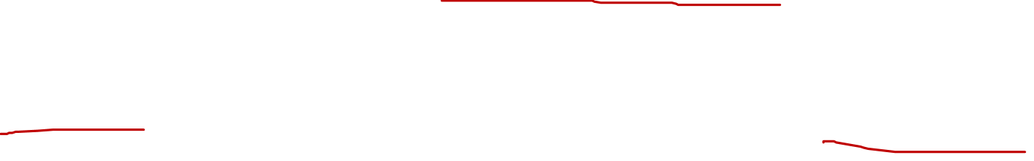
Fast R-CNN: RoI Pooling
Fast RCNN method receives region proposals from some external system (Selective search)
These proposals will be sent to the ROI Pooling layer that will resize all regions with their data to a fixed size.
This network layer can map input of different sizes to a vector of a set length

Slide 38
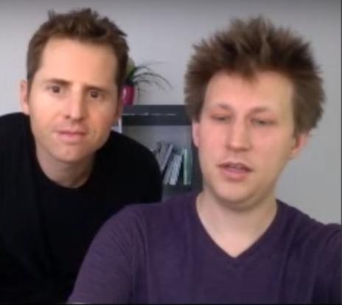
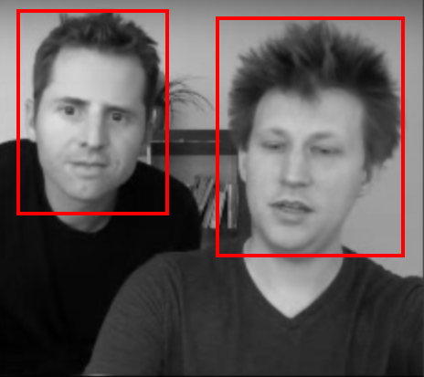
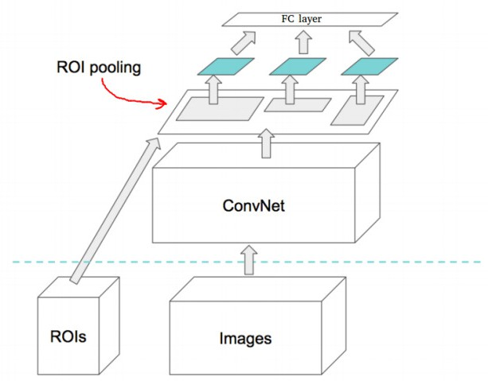
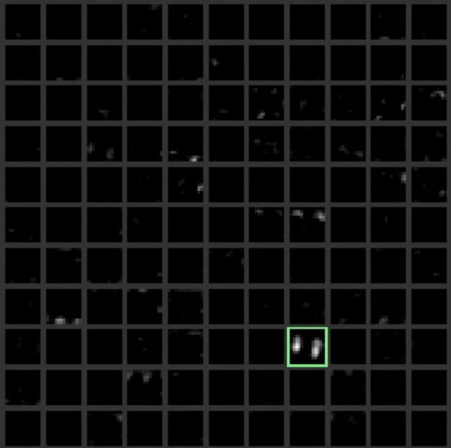
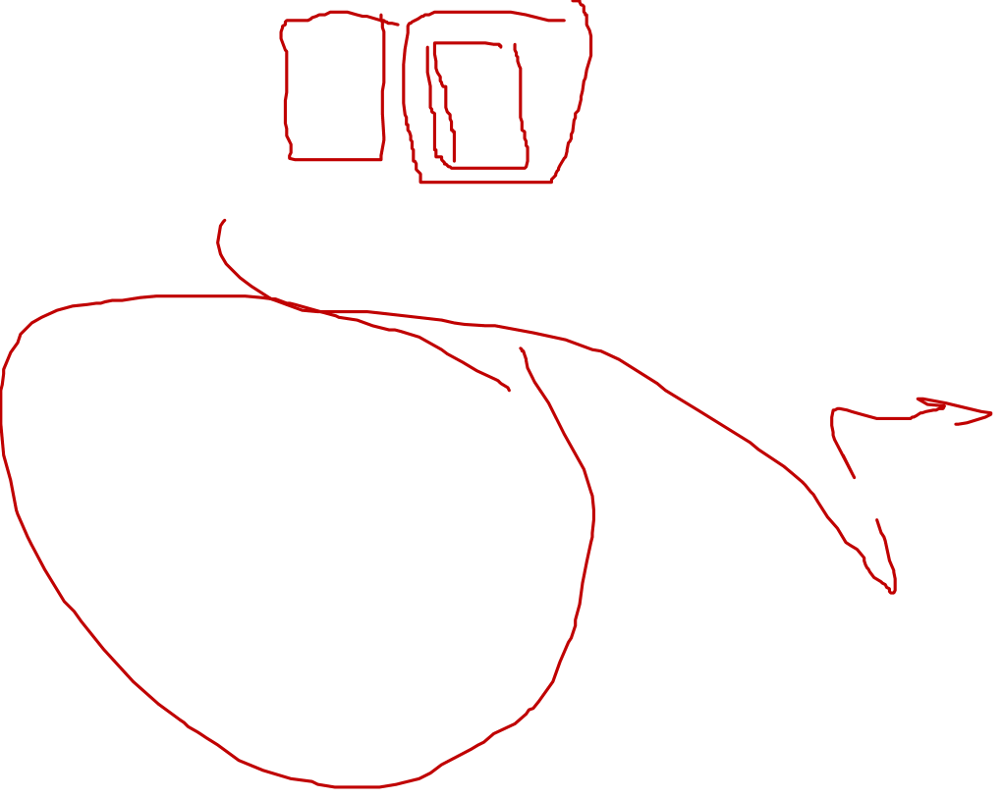
Fast R-CNN: RoI Pooling
Qasim
2020-06-29 01:34:21
--------------------------------------------
The blocks are the feature map output of CNN. There are different filters in each block
Each square box is one activation map (one feature map). These bright spots are representing the faces
Input Image
Two proposed regions
Activations on the last convolution layer (ex: conv5)

Slide 39

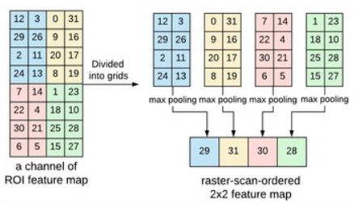
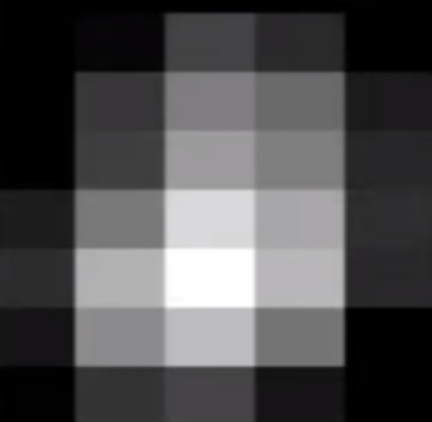
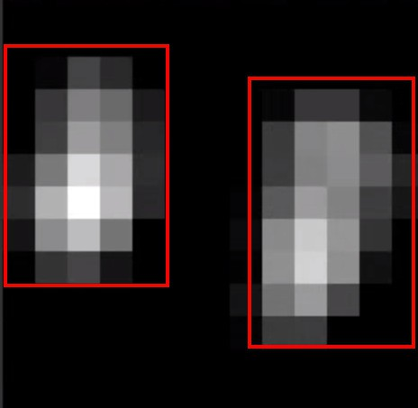
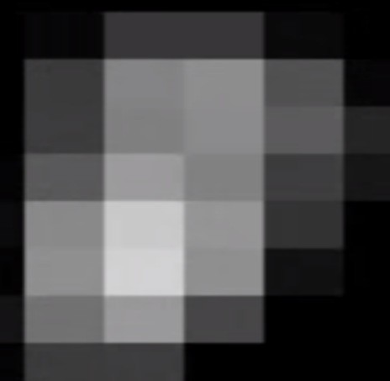
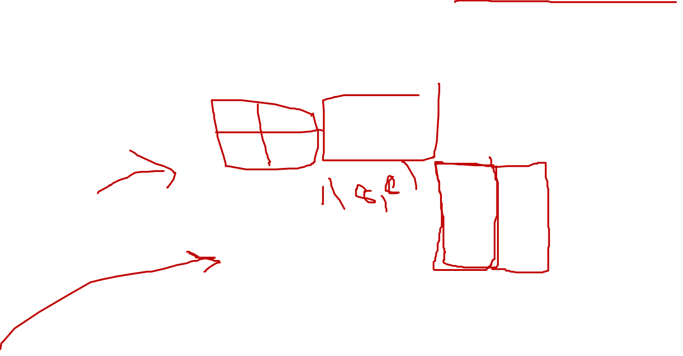
Fast R-CNN: RoI Pooling
For each convolution activation the ROI Pooling layer will resize, the region proposals (in red) to the same resolution expected on the fully connected layer.

Slide 40
Fast R-CNN: RoI Pooling Example
Example: Consider a region proposal of size h×w, and we would like to have an output of
H×W after pooling
The area of each pooling region = h/H × w/W
With input ROI of 5×7, and output of 2×2, the area for each pooling region is 2×3 or 3×3 after rounding.
The maximum value within the pooling window is taken as output value for each grid which is the same idea of conventional max pooling layer.

Slide 41
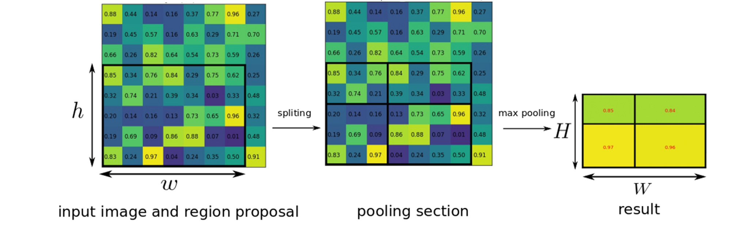
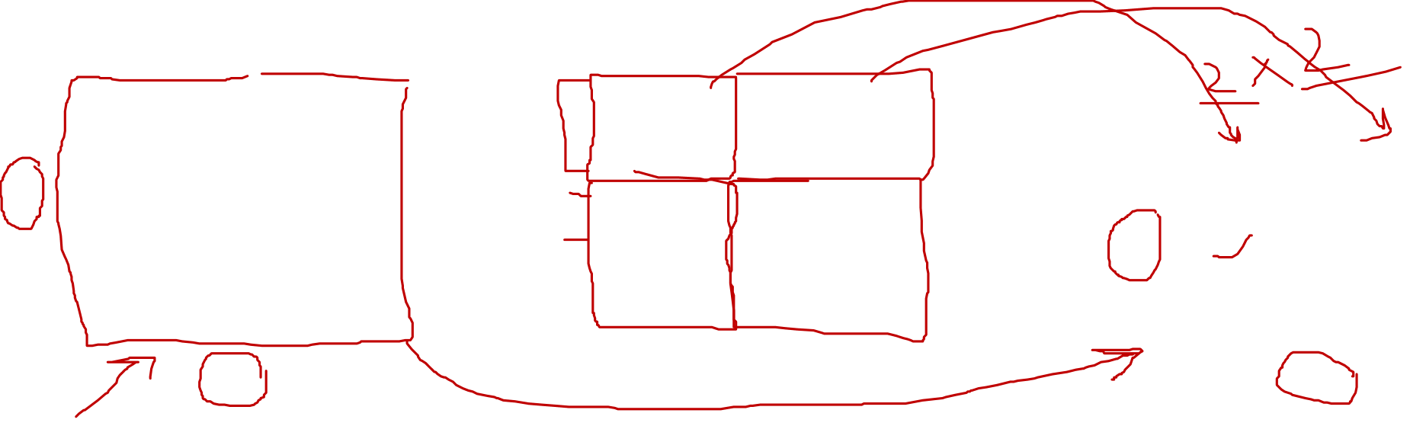
Fast R-CNN: RoI Pooling Example

Slide 42
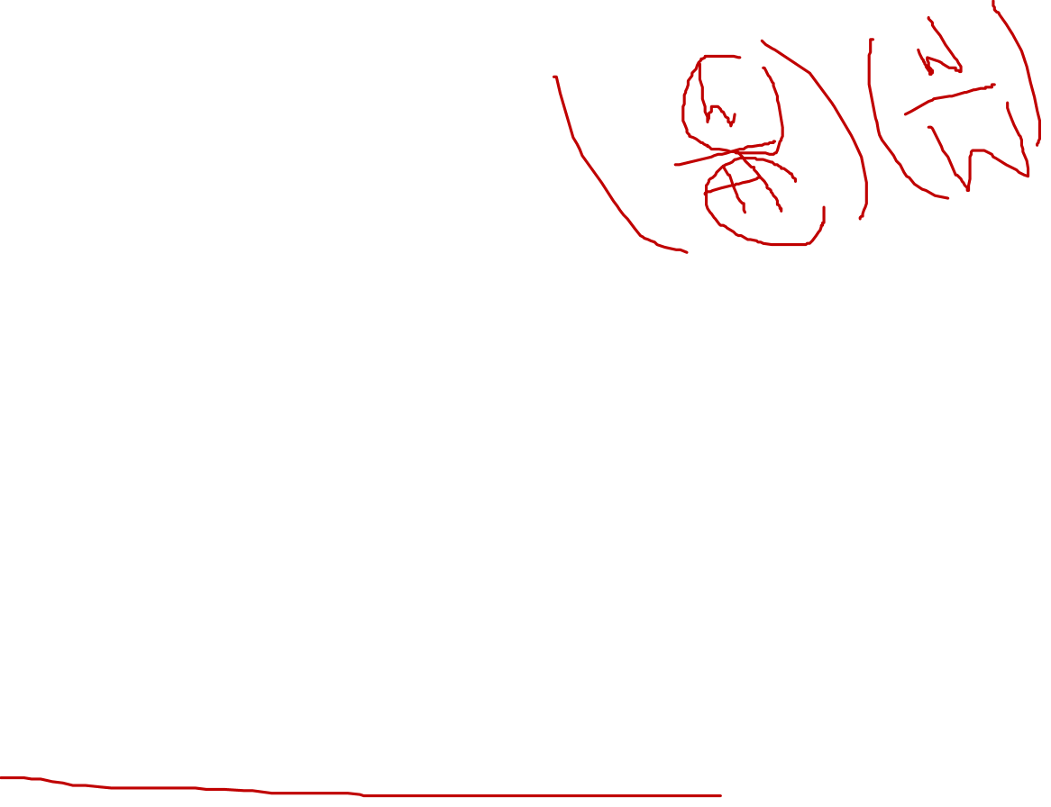
Fast R-CNN: Insights
The whole image (not individual regions) is passed through the convolutional layers only once.
This saves a lot of time because same patch may belong to multiple regions and convolutions on them are not calculated multiple time as done in RCNN thereby enabling a shared computation of conv layers among the regions.
After passing the image through conv layers, independent features need to be calculated for each of the regions generated by SS.
This can be done by performing ROI Pooling on JUST that section of the feature maps of last conv layer that corresponds to the region.

Slide 43
Fast R-CNN: Insights
The rectangular section of conv layer corresponding to a region can be calculated by projecting the region on conv layer by taking into account the down sampling happening in the intermediate layers
ROI Pooling layer divides a region of any arbitrary size into constant number of bins
Then max pool is performed on each of the bins.
Since number of bins remain the same, a constant size vector is produced

Slide 44
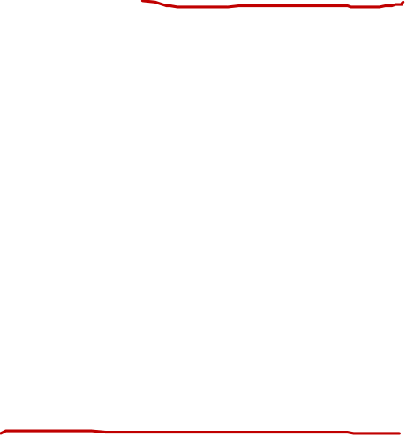
Fast R-CNN: Insights
Fast R-CNN jointly trains the CNN, classifier, and bounding box regressor in a single model.
In R-CNN, we had different models to extract image features (CNN), classify (SVM), and tighten bounding boxes (regressor)
Fast R-CNN instead used a single network to compute all three.
A single network has two loss branches pertaining to soft-max classification and bounding box regression.
This multitask objective is a salient feature of Fast-RCNN as it no longer requires training of the network independently for classification and localization.

Slide 45
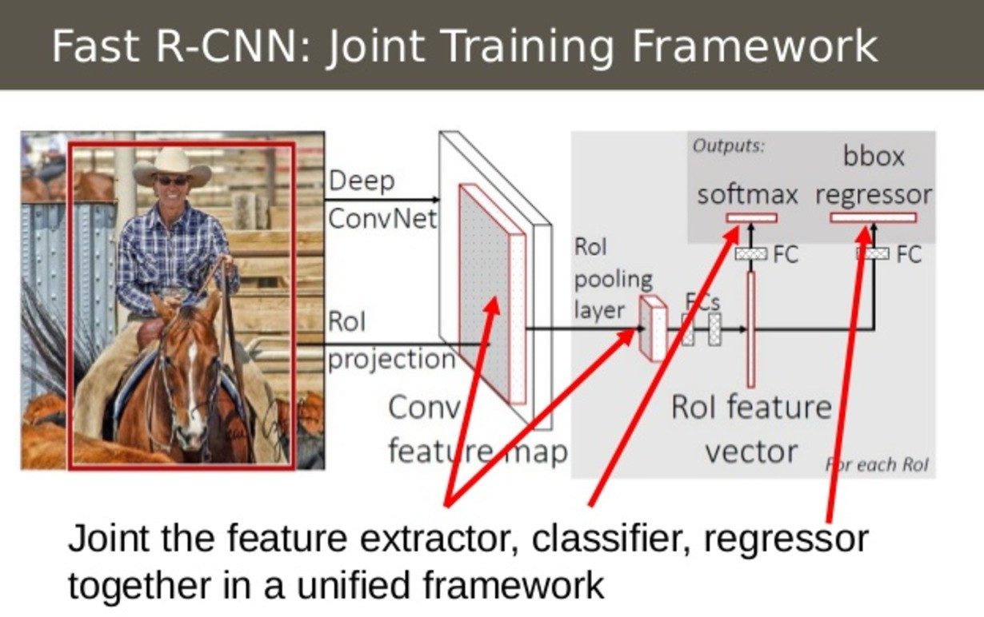

Fast R-CNN: Combining All Models into One Network

Slide 46


R-CNN vs. Fast R-CNN

Slide 47


R-CNN vs. Fast R-CNN

Slide 48
Thank You ☺

